Slide 1

CI/CD with Bitbucket and R
SLC R Users Group Meetup
Mark Nielsen
Data Scientist/ML Engineer
2 Nov 2022
This Photo by Unknown Author is licensed under CC BY-SA

Slide 2
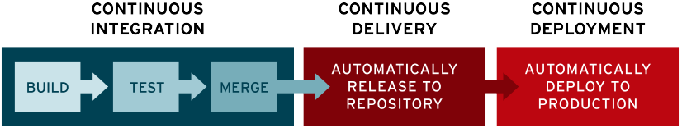

What is CI/CD?
What is CI/CD? (redhat.com)

Slide 3
Case Study
NCAAcalcutta package

Slide 4
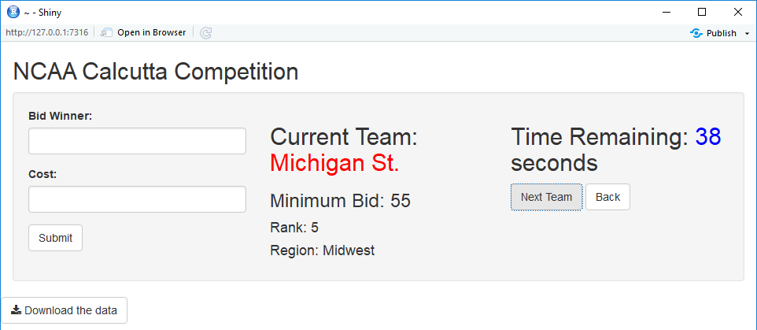
NCAAcalcutta package
GitHub - nielsenmarkus11/NCAAcalcutta

Slide 5
Package Development in R
usethis, devtools, and other packages

Slide 6
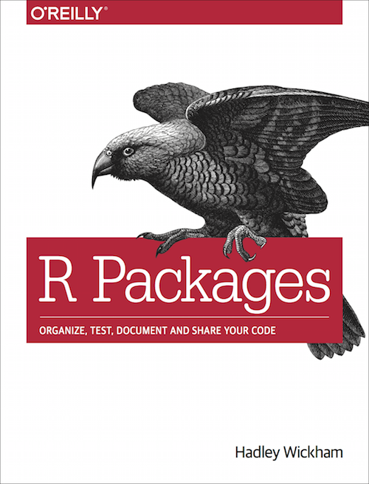




Package development book
R Packages (2e) (r-pkgs.org)

Slide 7
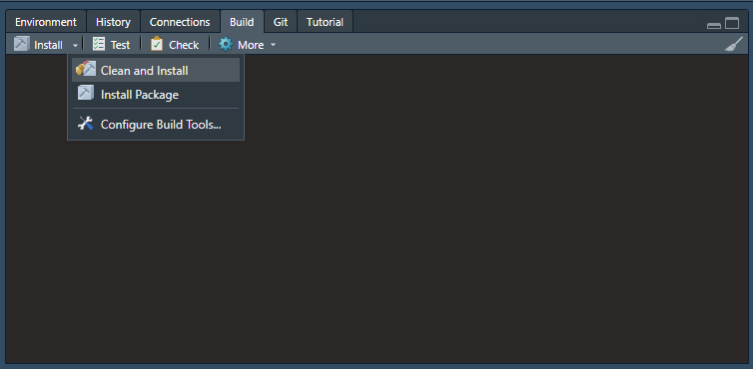
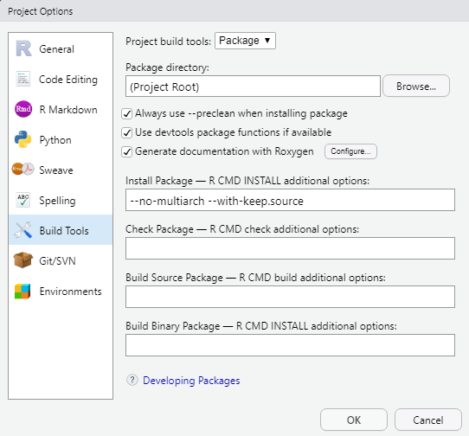
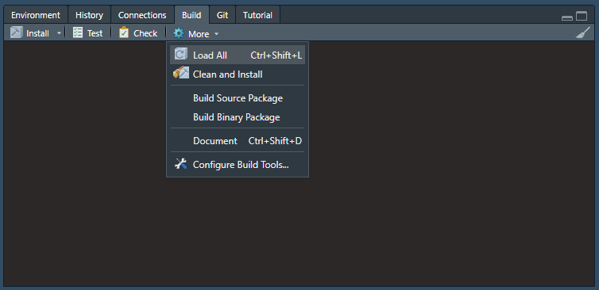
RStudio Build tab and menus demo

Slide 8
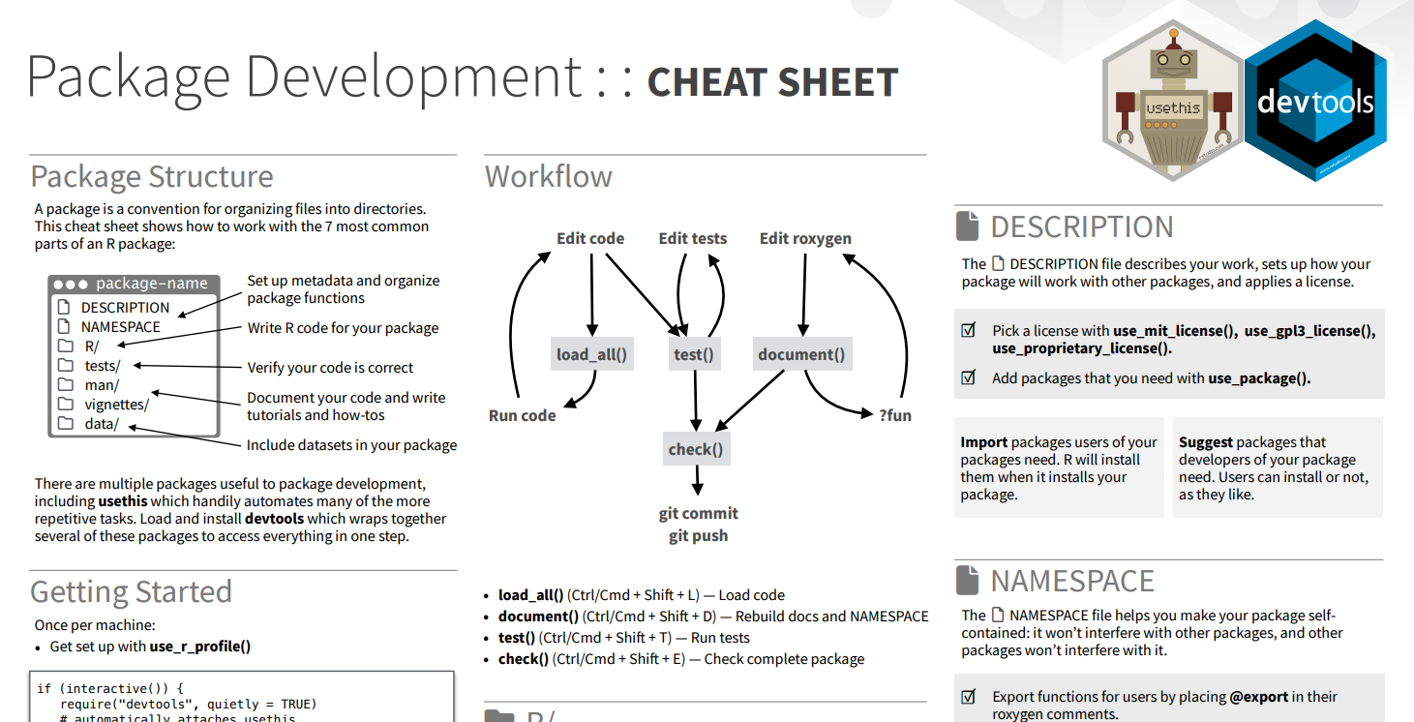

Slide 9
NCAAcalcutta Goals – With every push, automate…
Package document and check
Linting for automated code reviews
Unit tests
Build and deploy to production
Enforcement of basic code style guide
CI/CD

Slide 10
Atlassian Bitbucket
Git repository management
Bitbucket | Git solution for teams using Jira

Slide 11
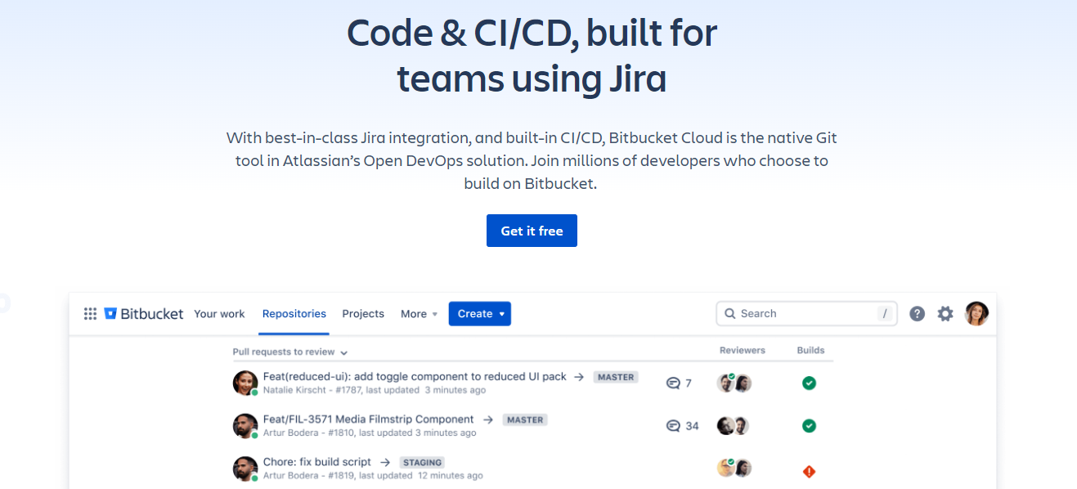
What are Bitbucket and Bitbucket Pipelines?

Slide 12






Other CI/CD Tools

Slide 13
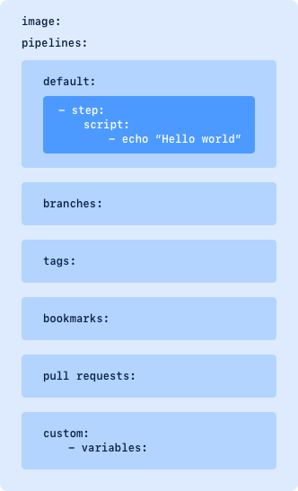
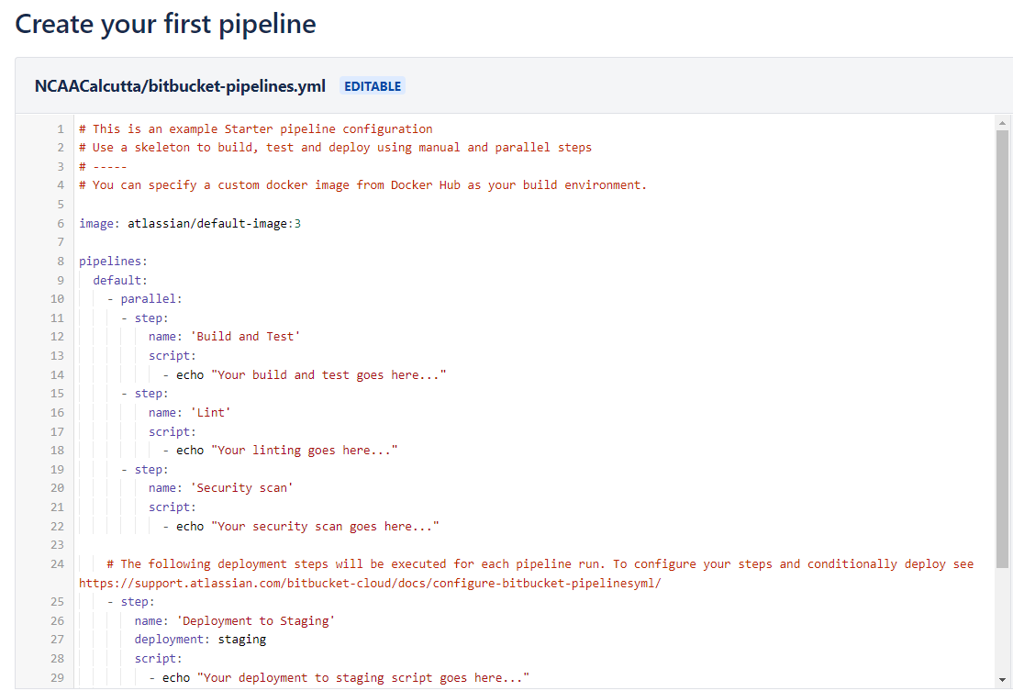
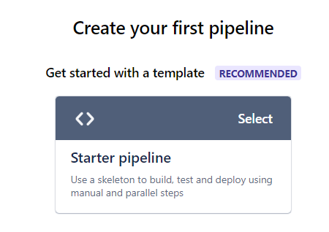
Bitbucket Pipelines Basics
Get started with Bitbucket Pipelines | Bitbucket Cloud | Atlassian Support

Slide 14
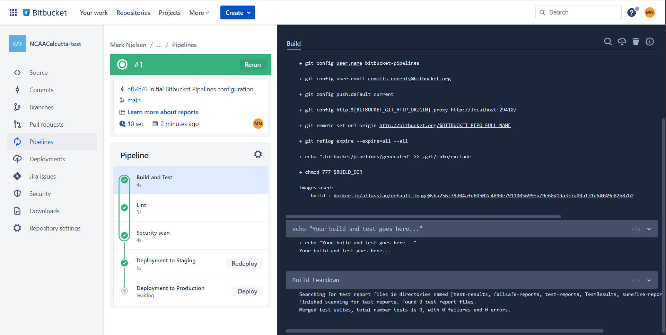
Demo output

Slide 15
devtools Demo
Document and Check
Tools to Make Developing R Packages Easier • devtools (r-lib.org)

Slide 16
Demo
image: rocker/tidyverse:4.0.2
definitions:
caches:
site-library: /usr/local/lib/R/site-library
pipelines:
default:
- step:
name: 'Document and Check'
caches:
- site-library
script:
- Rscript -e 'devtools::install_deps(dependencies=TRUE)'
- Rscript -e 'devtools::document()'
- Rscript -e 'devtools::check()'

Slide 17
Function customization
devtools::install_deps()
dependencies = TRUE
repos = <set your favorite repo here>
devtools::check()
vignettes = FALSE
error_on = “error”

Slide 18
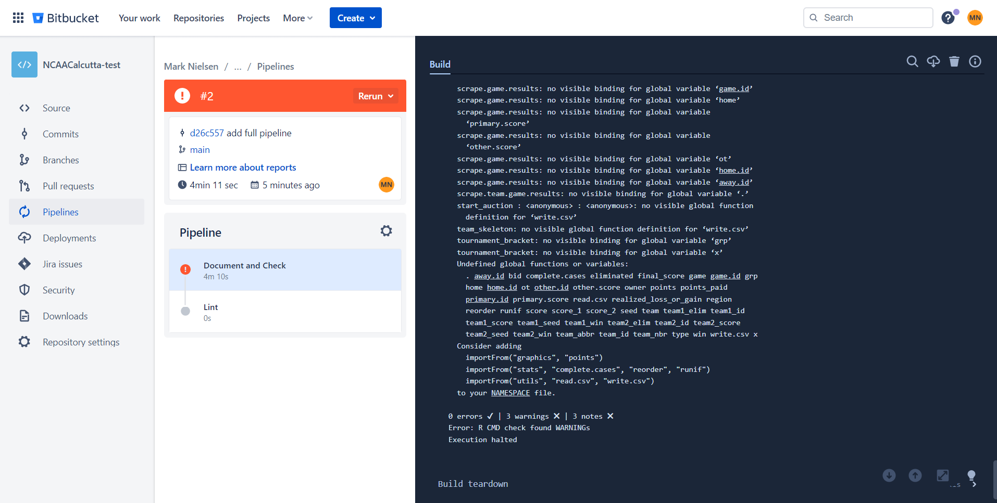
Demo output

Slide 19
lintr Demo
Code linting for R
A Linter for R Code • lintr (r-lib.org)

Slide 20
Demo
- step:
name: 'Lint'
caches:
- site-library
script:
- Rscript -e 'install.packages("lintr")'
- Rscript -e 'lintr::lint_package(linters = lintr::with_defaults(line_length_linter = NULL, object_name_linter = NULL))'

Slide 21
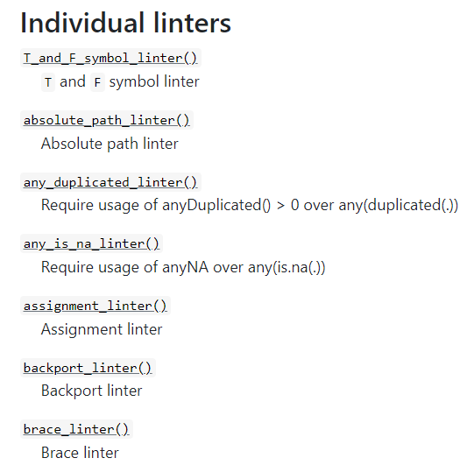
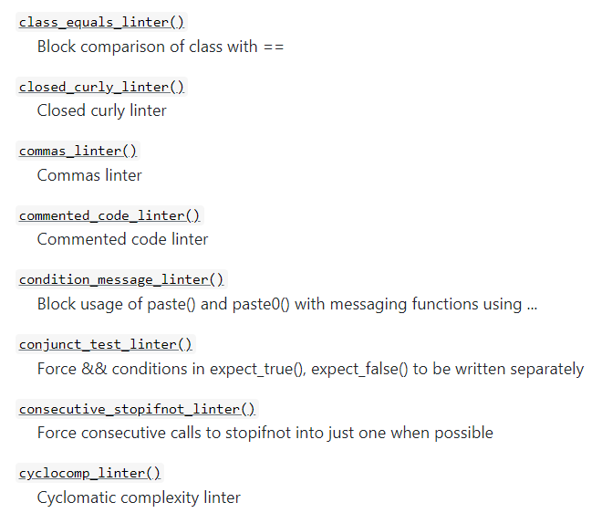

Standards customization
linters = lintr::with_defaults(<change defaults>)

Slide 22
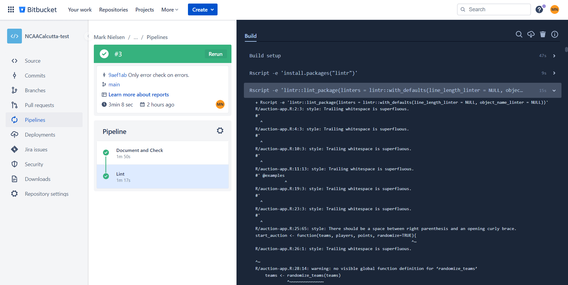
Demo output

Slide 23
testthat Demo
Unit testing
Unit Testing for R • testthat (r-lib.org)

Slide 24
Demo
test_that("bracket_draw_left returns a dataframe", {
x <- 1
y <- 3
l <- 2
w <- 2
dat <- data.frame(x=c(x,x+l,x+l,x),y=c(y+w,y+w,y-w,y-w))
outdat <- bracket_draw_left(x,y,l,w)
expect_identical(dat, outdat)
})
bitbucket-pipelines.yml
pull-requests:
'**':
- step:
name: 'Test'
caches:
- site-library
script:
- Rscript -e 'devtools::test()'

Slide 25
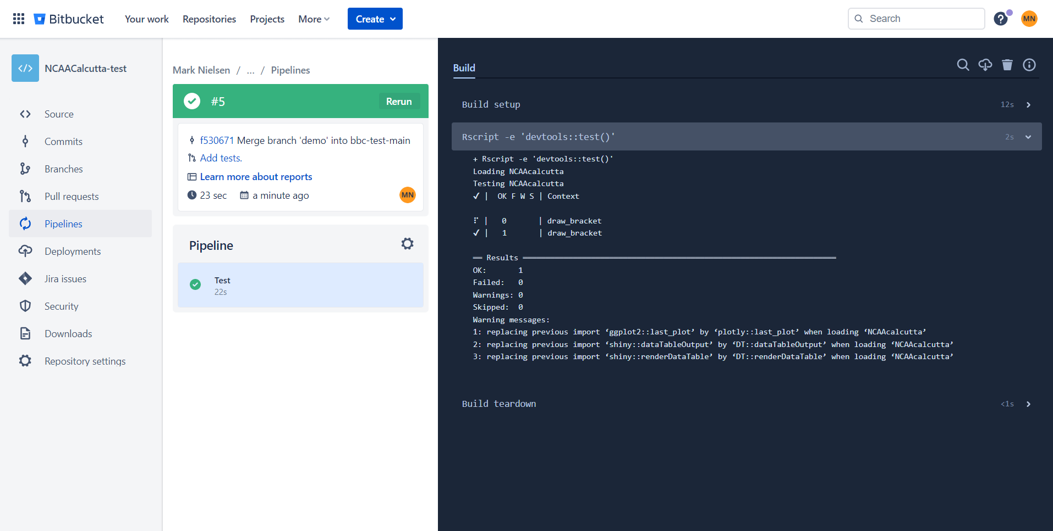
Demo output

Slide 26
devtools and Nexus
R Package Build and Deployment
R Repositories (sonatype.com)

Slide 27
Example (Step 1)
tags:
'*':
- step:
name: 'Build'
image: rocker/tidyverse:4.0.2
caches:
- site-library
script:
- Rscript -e 'devtools::install_deps(dependencies=TRUE)'
- Rscript -e 'devtools::document()'
- Rscript -e 'devtools::build(path="deploy", vignettes = FALSE)'
artifacts:
- deploy/*.tar.gz

Slide 28
Example (Step 2)
- step:
name: 'Deploy'
image: curlimages/curl:latest
trigger: manual
deployment: Production
script:
- export filename=`ls deploy | grep tar.gz`
- echo $filename
- curl -v --user "$NEXUS_USER:$NEXUS_PASS" --upload-file deploy/$filename http://<host>:<port>/repository/<repository_name>/src/contrib/$filename

Slide 29
Function customization
devtools::install_deps()
dependencies = TRUE
repos = <set your favorite repo here>
devtools::build()
path = <artifact-folder>
vignettes = FALSE

Slide 30
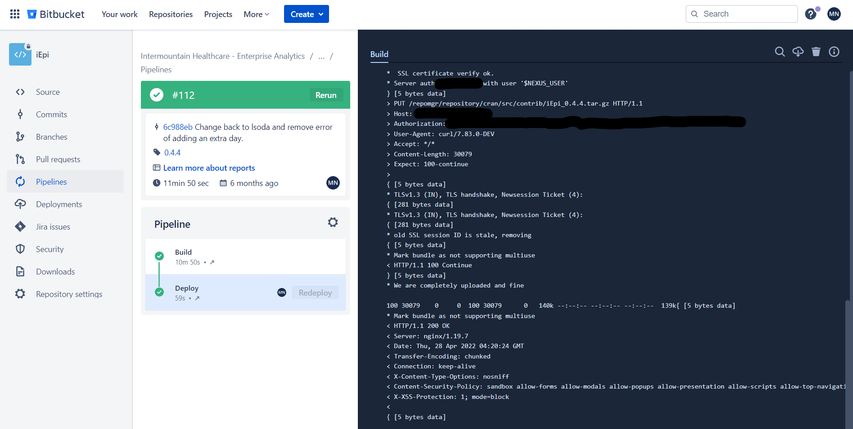
Example output

Slide 31
styler
Automatic code styling
Non-Invasive Pretty Printing of R Code • styler (r-lib.org)

Slide 32
Example (Step 1)
Set up Oauth2 for Bitbucket…
… may be a premium feature.

Slide 33
Example (Step 1)
steps:
- step: &create-pr
name: Create Pull Request
image: everpeace/curl-jq
caches:
- node
script:
- export DESTINATION_BRANCH="${BITBUCKET_BRANCH}"
- export CLOSE_ME=true
- >
export BB_TOKEN=$(curl -s -S -f -X POST -u "${BB_AUTH_STRING}" \
https://bitbucket.org/site/oauth2/access_token \
-d grant_type=client_credentials -d scopes="repository" | jq --raw-output '.access_token')
- >
export DEFAULT_REVIEWERS=$(curl https://api.bitbucket.org/2.0/repositories/${BITBUCKET_REPO_OWNER}/${BITBUCKET_REPO_SLUG}/default-reviewers \
-s -S -f -X GET \
-H "Authorization: Bearer ${BB_TOKEN}" | jq '.values' | jq 'map({uuid})' )
- >
curl https://api.bitbucket.org/2.0/repositories/${BITBUCKET_REPO_OWNER}/${BITBUCKET_REPO_SLUG}/pullrequests \
-s -S -f -X POST \
-H 'Content-Type: application/json' \
-H "Authorization: Bearer ${BB_TOKEN}" \
-d '{
"title": "Merge in '"${BITBUCKET_BRANCH}-styler"'",
"description": "Automated PR creation process :-)",
"source": {
"branch": {
"name": "'"${BITBUCKET_BRANCH}-styler"'"
}
},
"destination": {
"branch": {
"name": "'"${DESTINATION_BRANCH}"'"
}
},
"close_source_branch": '"${CLOSE_ME}"',
"reviewers": '"${DEFAULT_REVIEWERS}"'
}'
Bitbucket Pipelines - Create Pull Request (PR) with default reviewers · GitHub

Slide 34
Example (Step 2b)
- step:
name: "Automatic styler"
image: rocker/tidyverse:4.0.2
trigger: manual
script:
- Rscript -e 'install.packages("styler")'
- Rscript -e 'styler::style_pkg()'
- git checkout -b ${BITBUCKET_BRANCH}-styler
- git commit -am "[skip ci] Automatic styler."
- git push
- step: *create-pr

Slide 35
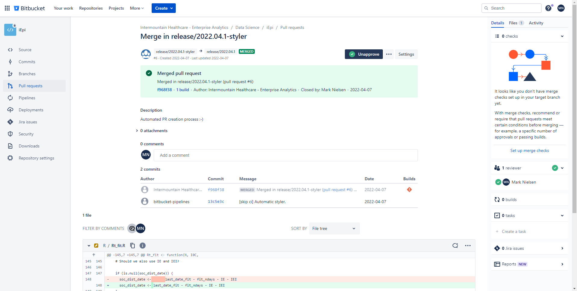
Example output

Slide 36
Automation next steps
Coverage, badges, etc.

Slide 37
Appendix – Additional Sources
Automate Package and Project Setup • usethis (r-lib.org)
In-Line Documentation for R • roxygen2 (r-lib.org)
Mixing Up Your Office March Madness Competition · nielsenmark.us
Nexus Repository Manager - Binary & Artifact Management | Sonatype

